Slide 1
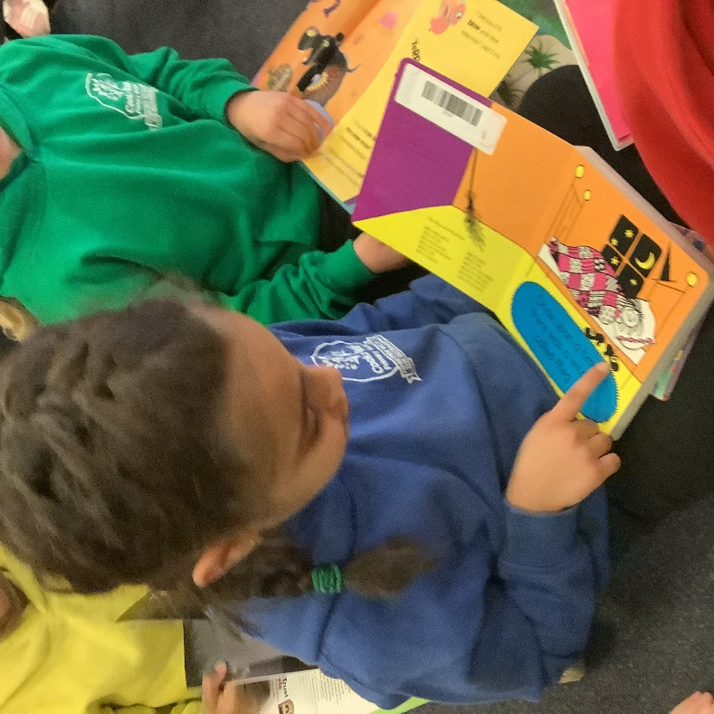
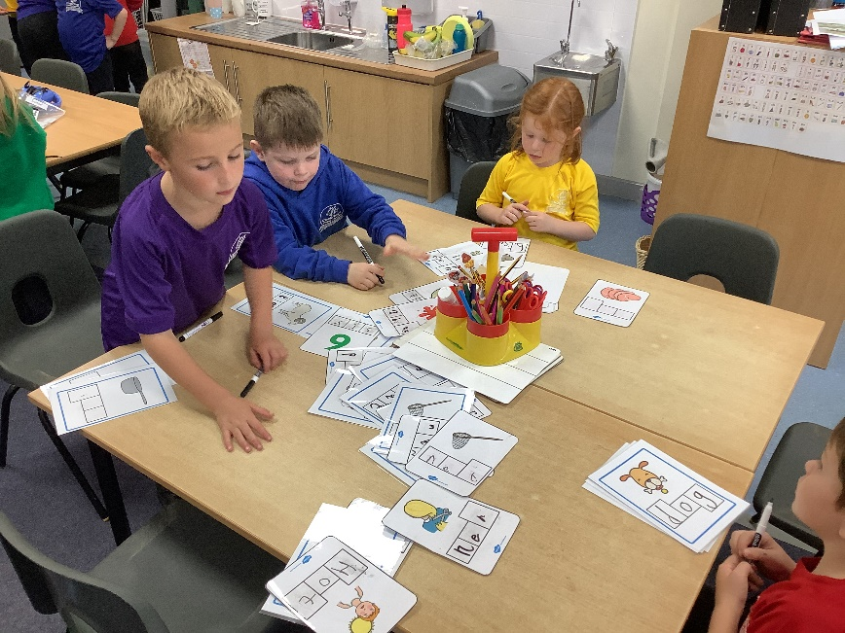
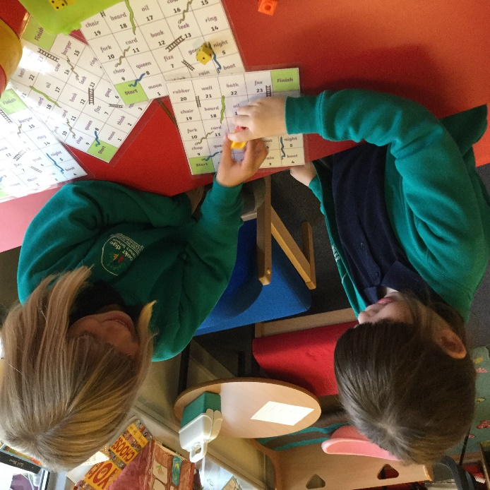
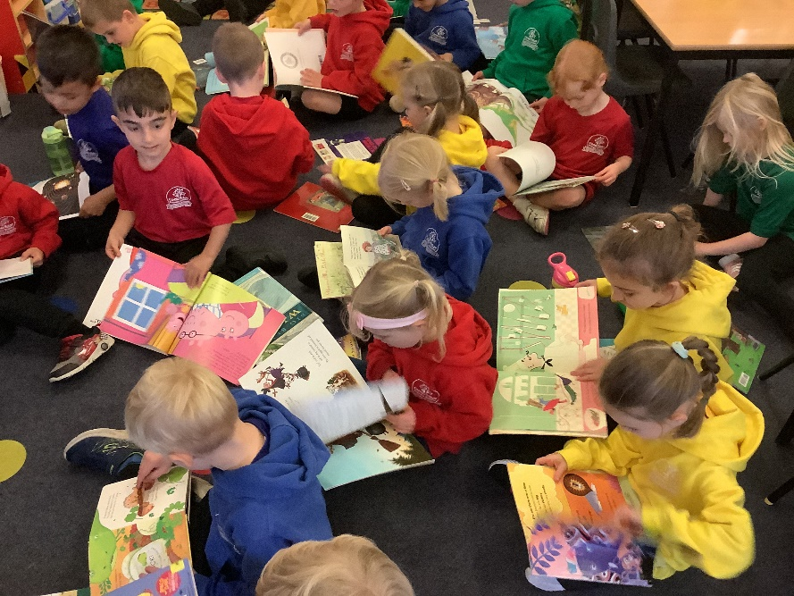
PHONICS & READING

Slide 2
What is Phonics?
Why do we teach it?

Slide 3
Teaching phonics is all part of holistic literacy. It’s repetitive, which helps those that struggle with a short term memory. It can be fun and differentiated and over it all it will give the child the confidence to grow and develop a love of reading.

Slide 4
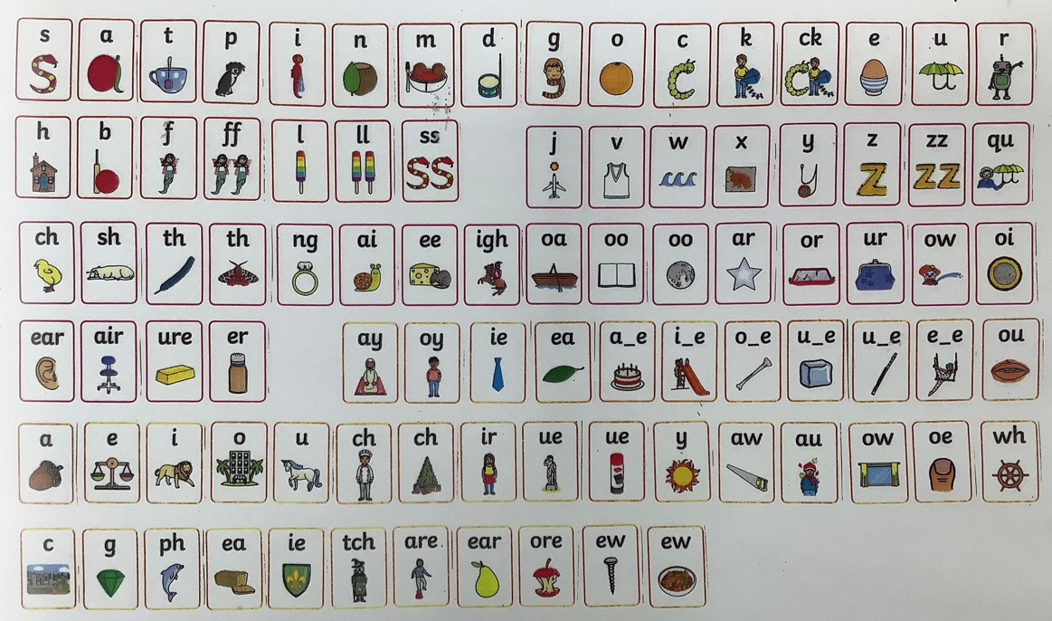
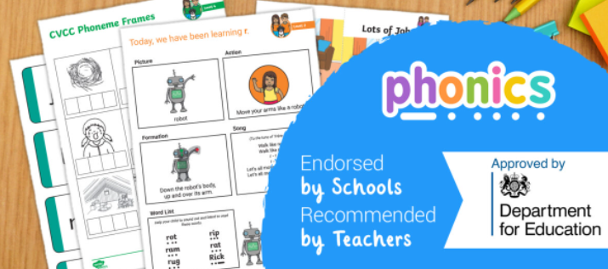
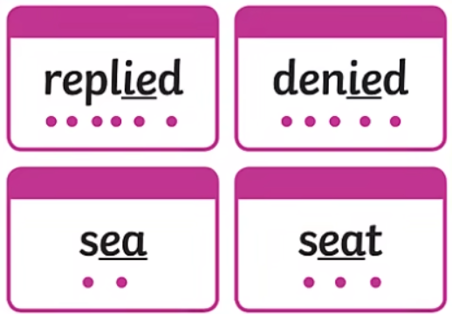

Slide 5
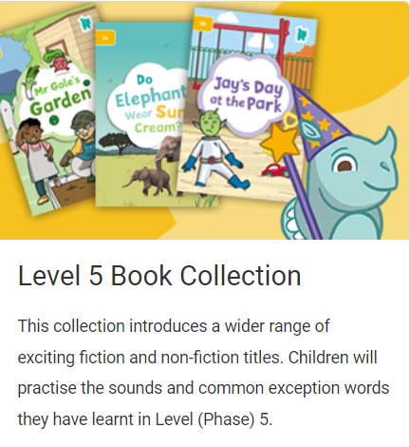
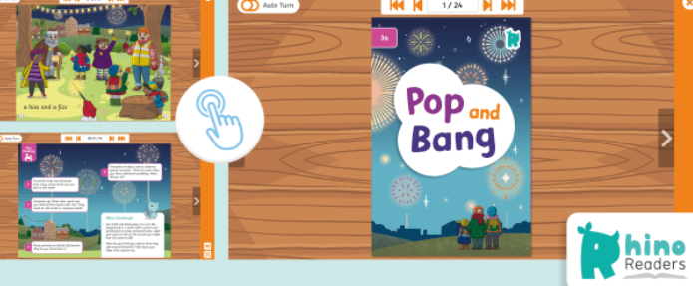

Slide 6
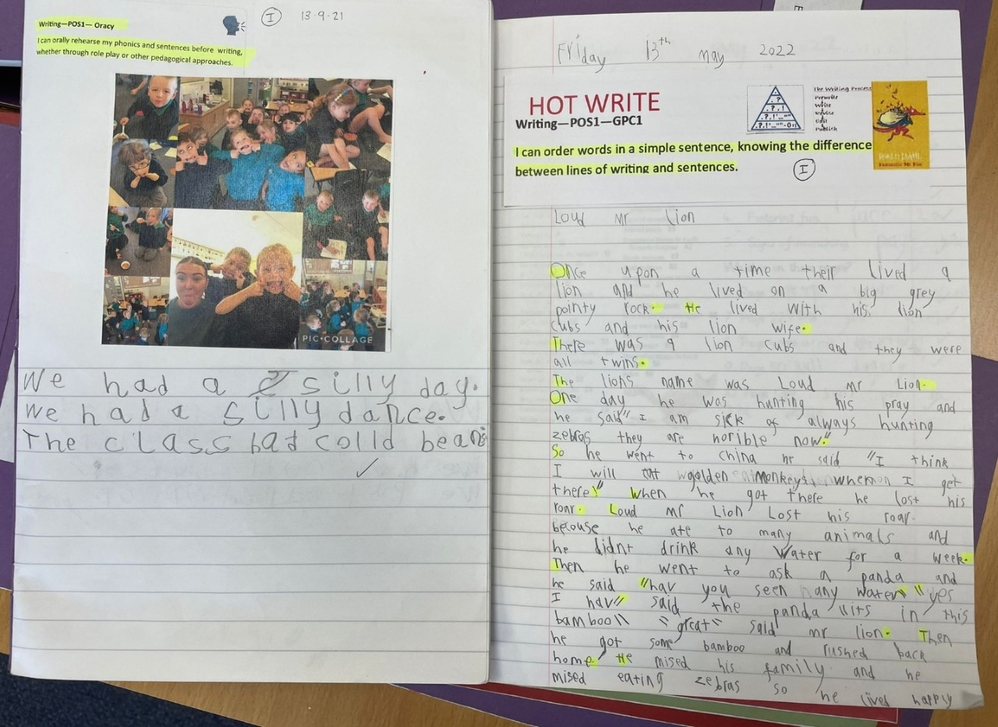
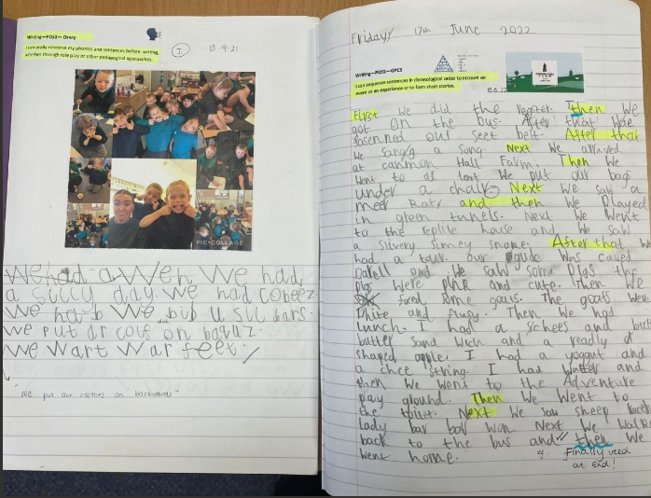
Writing progression in Year One

Slide 7
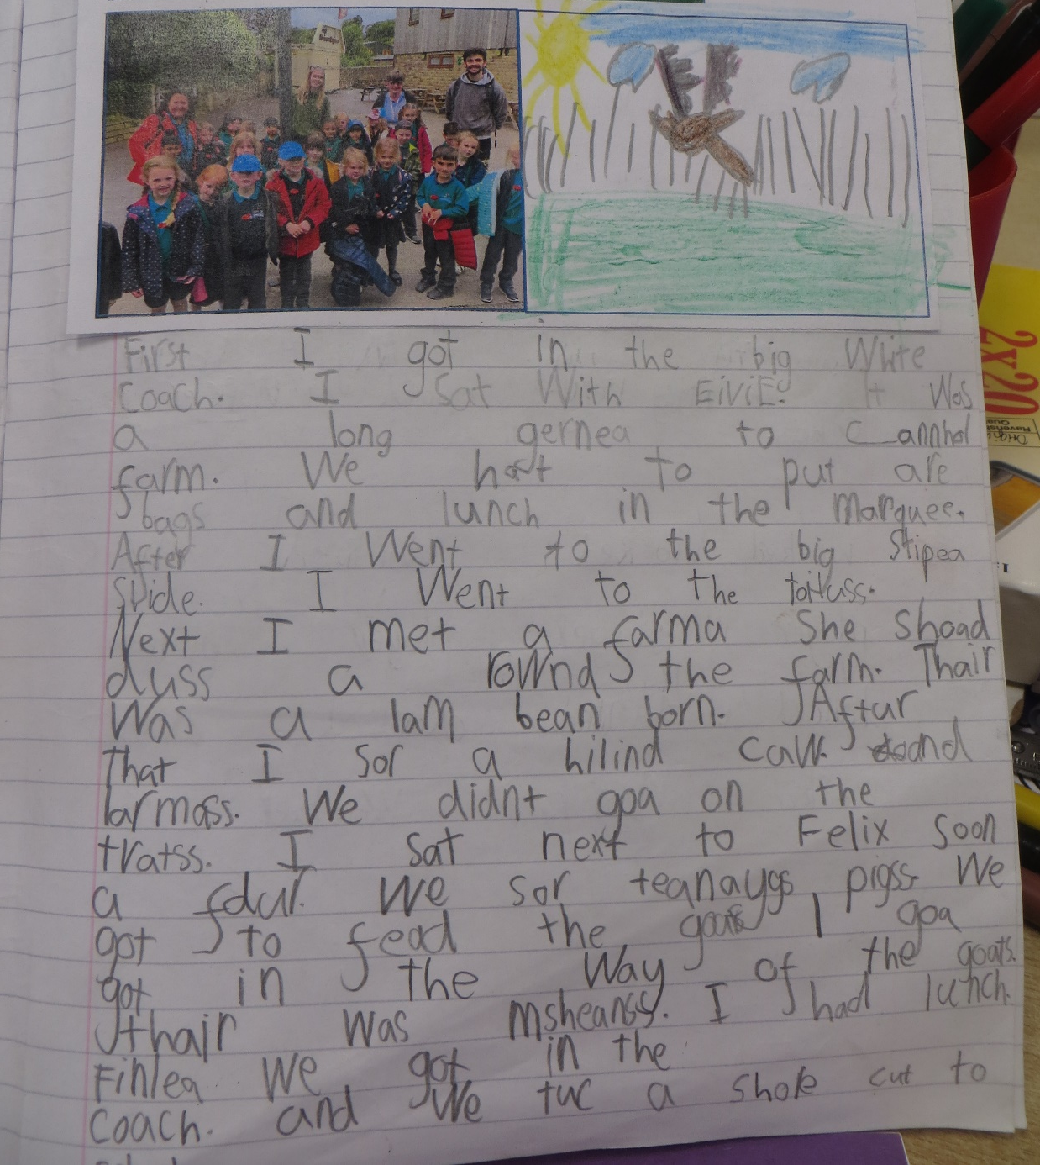
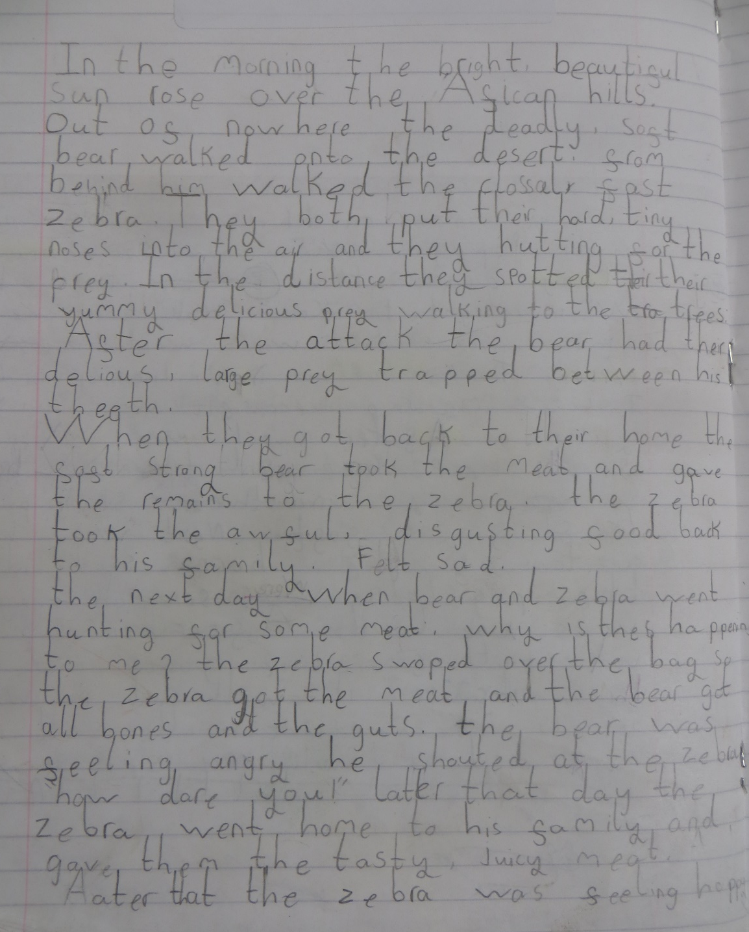
Year One Expected
Year Two Expected

Slide 8
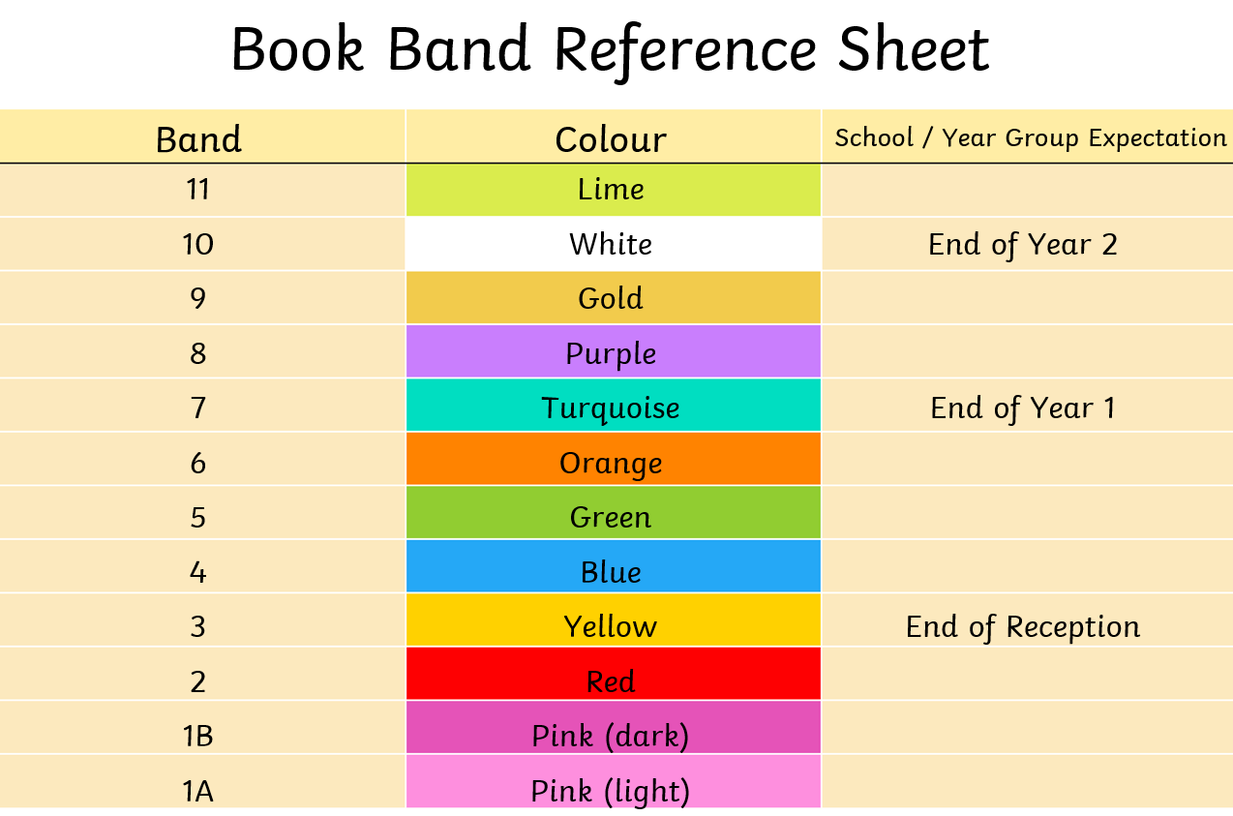
Book band progression
This is just an overview. We understand that every child progresses at their own pace.

Slide 9
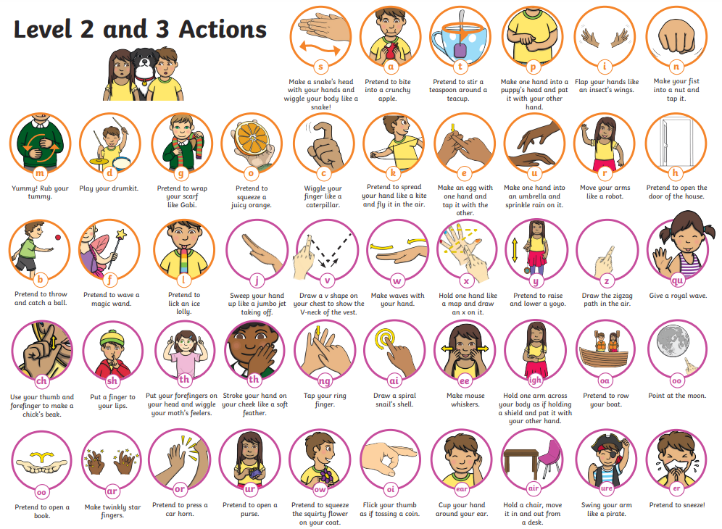
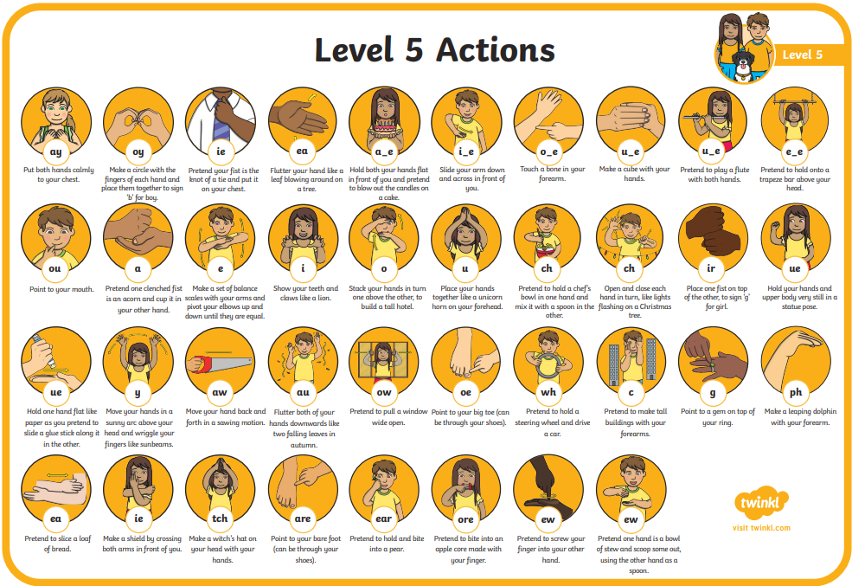

Slide 10
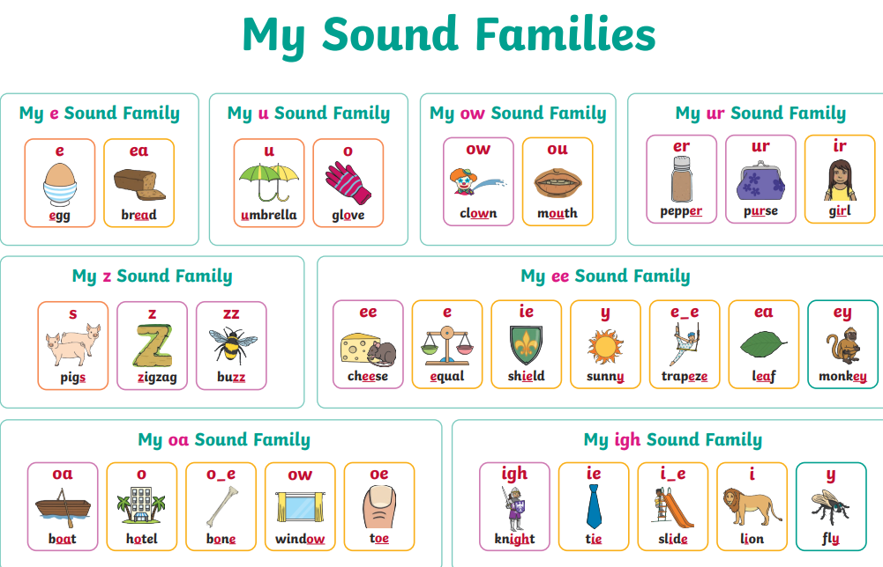

Slide 12
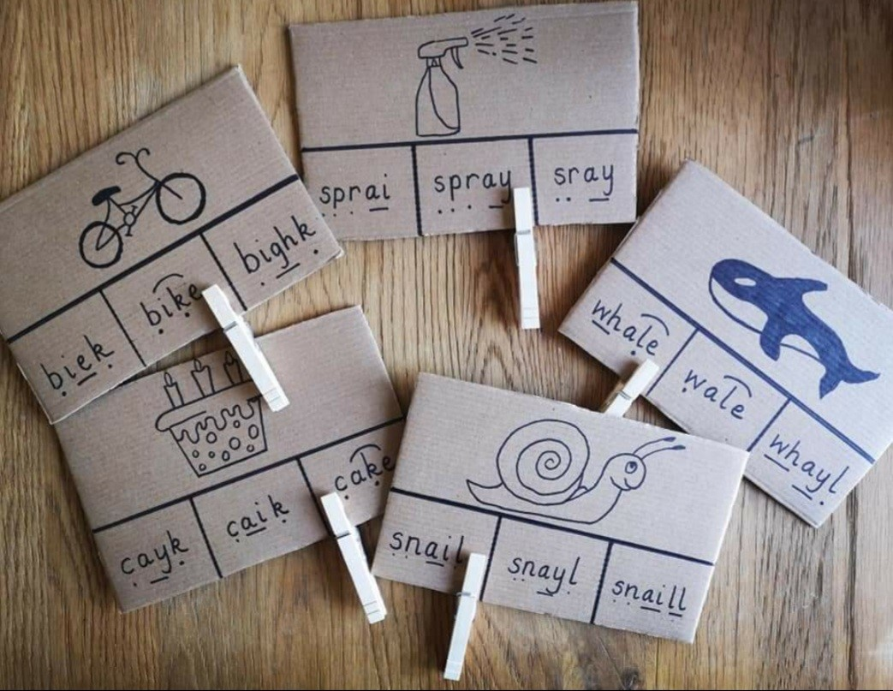
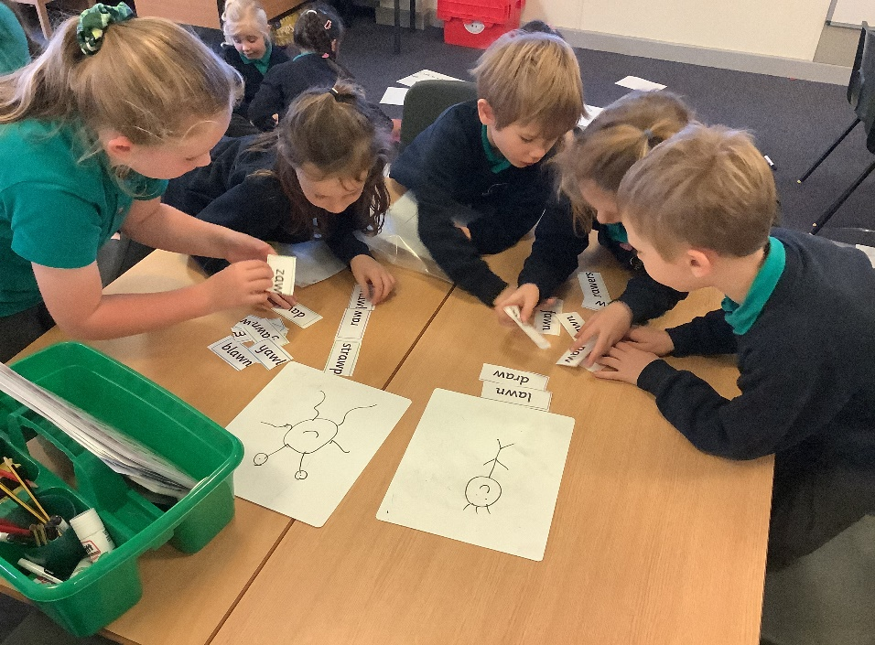
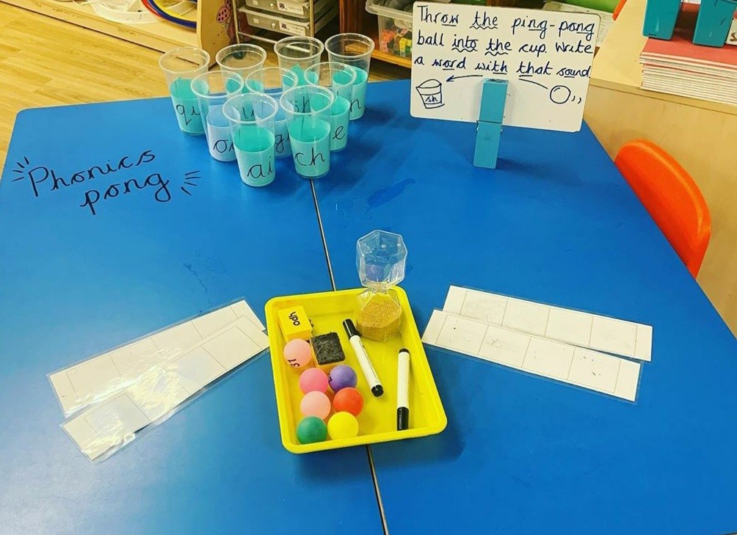
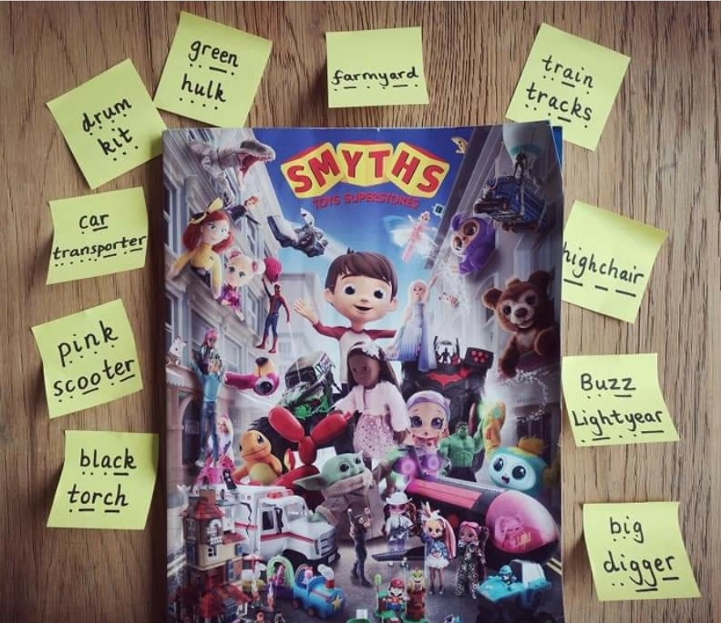
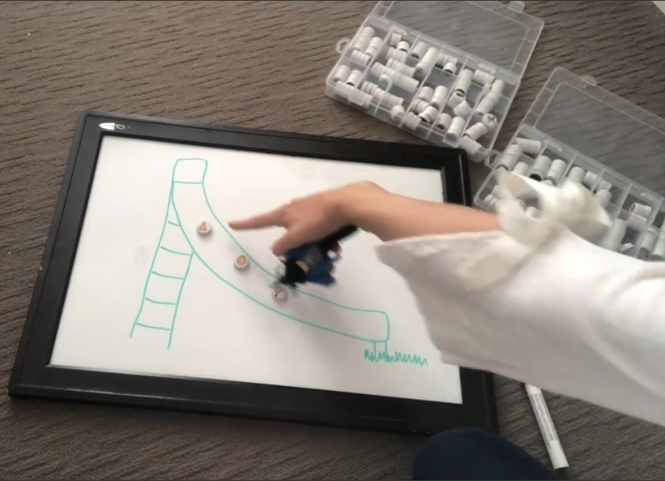
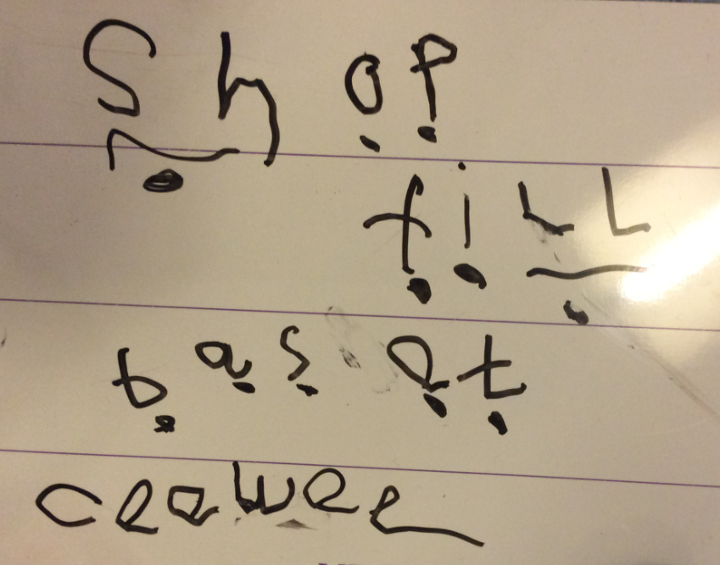

Slide 13
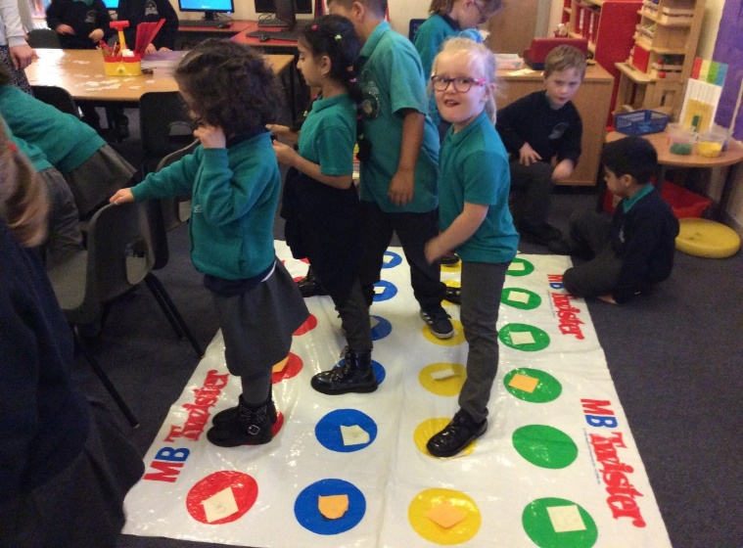
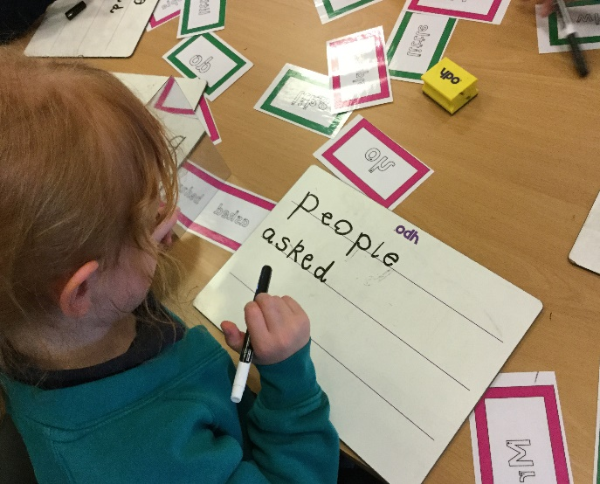
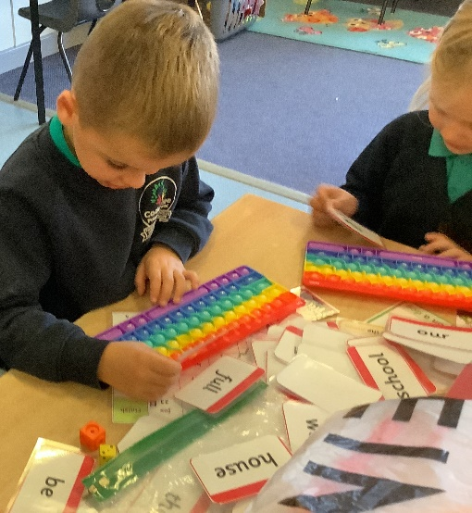
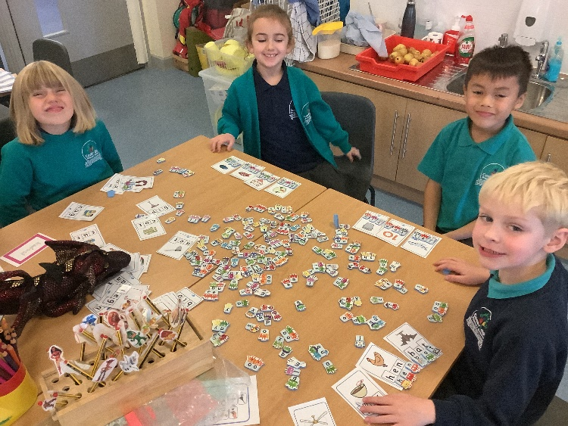
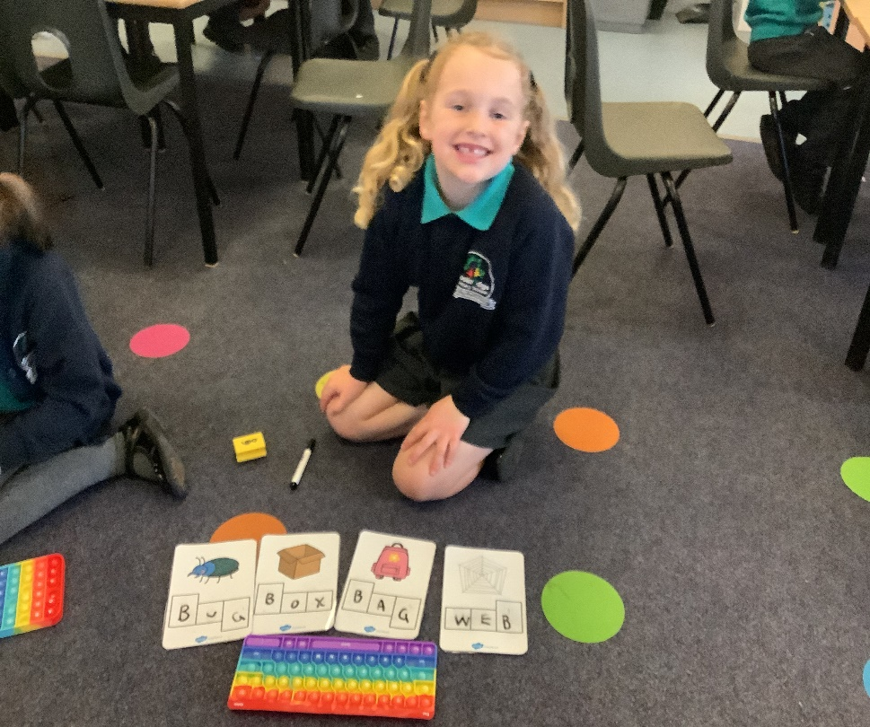
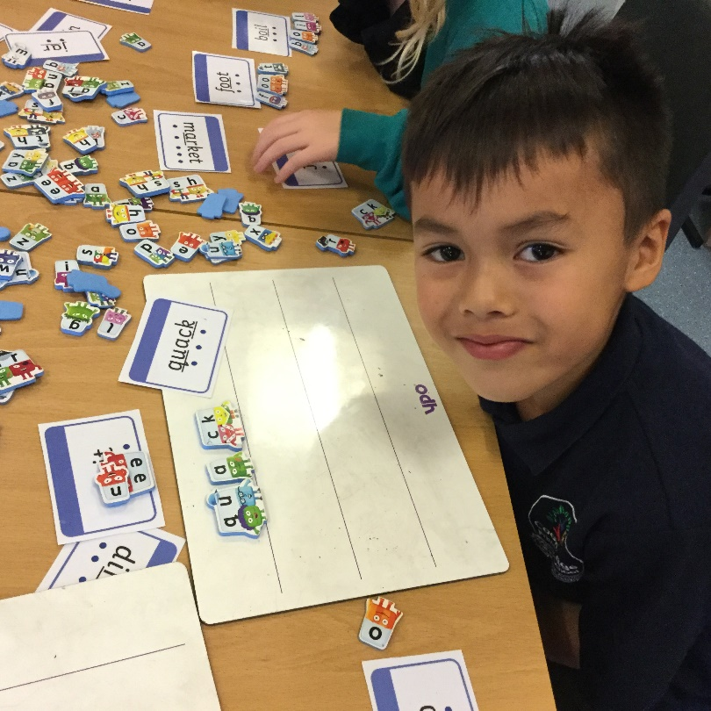
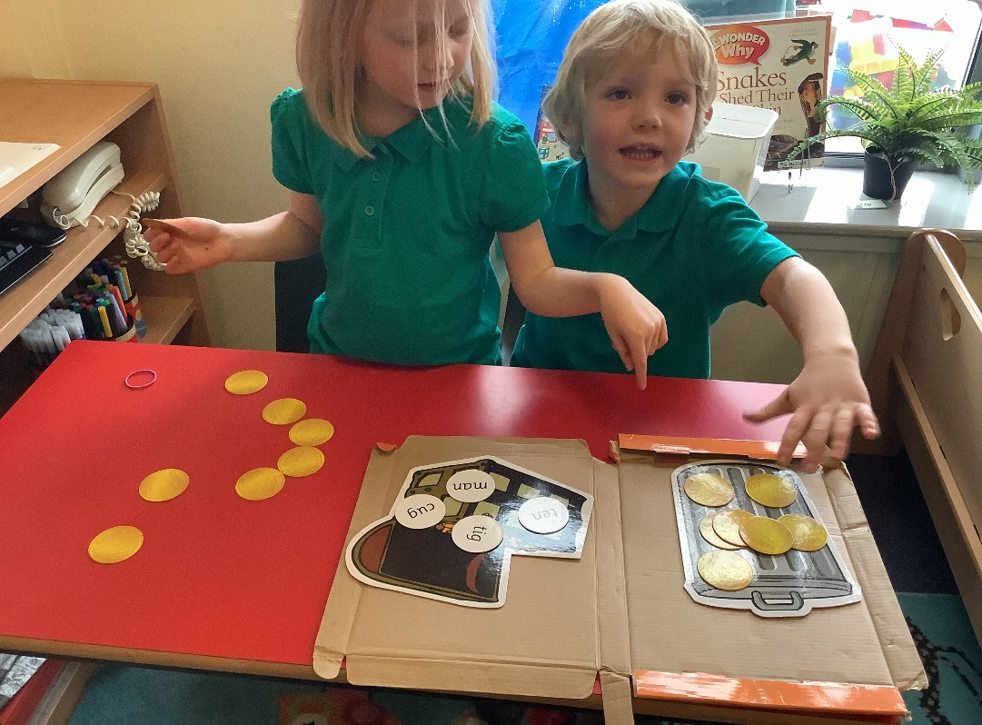
Games

Slide 14
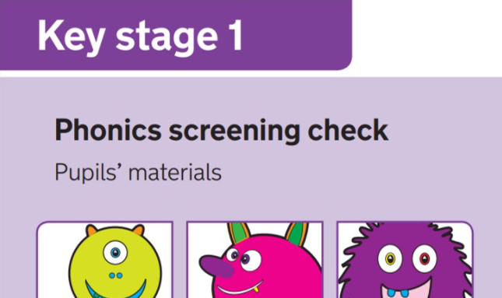
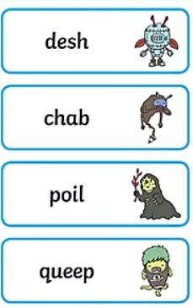
Phonics Screening test
Results from the check will be used by schools to analyse their own performance and for Ofsted to use in inspections.

Slide 15
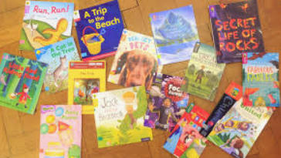
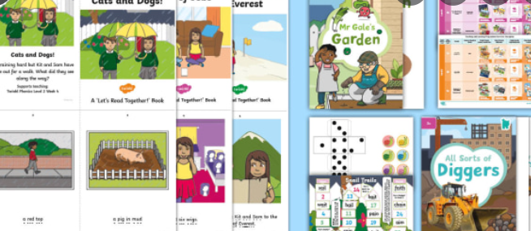
Reading
-Read at least 3 times a week
-Reading diary- please comment and initial.
-They have the opportunity to change their book everyday

Slide 16
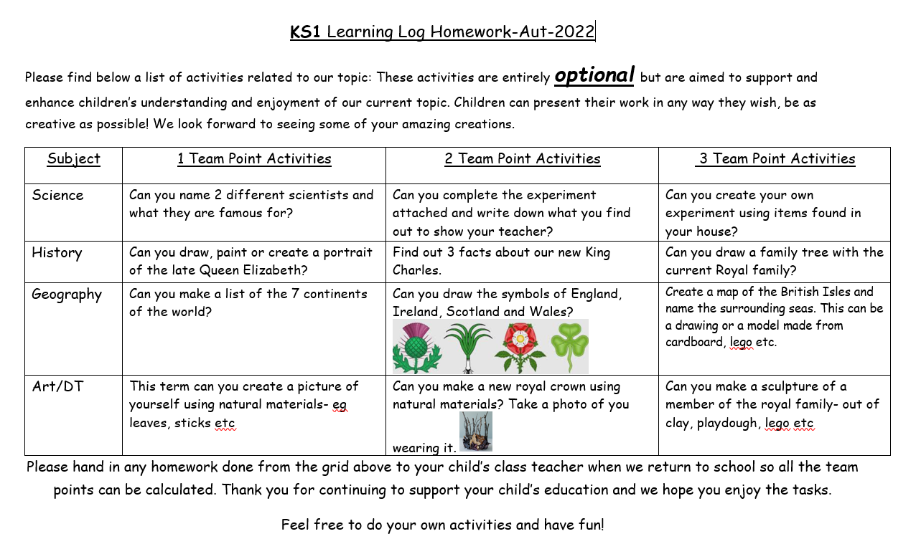

Slide 17
Useful websites/reading
Phonics Play – Planning, resources and online games
Oxford Owl –Ebooks to read and resources
https://www.twinkl.co.uk/resource/t-l-526364-phonics-screening-check-parents-information-pack-and-home-learning-tasks
https://www.twinkl.co.uk/resource/t-l-2409-parents-phonics-screening-check-resource-pack
What is Synthetic Phonics?- A summary

Slide 18
Visit your child’s classroom to see range of games and activities
3.10pm- Parents to leave and wait by gate
Pick up children at 3.20pm

